Slide 1

Online Mobile Recharge System
PROJECT – ASP.NET WEB API
RPAY

Slide 2



OUR TEAM
NAVEETH Z A RAJAGURUNATHAN M SARAVANAKUMAR B

Slide 3

AGENDA
Introduction
Project Objective & Flow
Database Design
User Module
Admin Module

Slide 4

INTRODUCTION
Online Mobile Recharge System is a Web
Based Application(RPAY) developed to recharge
Mobile Phones.
This System Focuses At Providing An Easy
And Reliable Platform To Recharge Mobile
Of Any Telecommunication Company Through
Online Without Buying Recharge Card

Slide 5
PROJECT OBJECTIVE
The proposed project for recharging mobiles developed to automate the mobile recharging process.
It roots out the manual card system of recharge and introduces a new and genuine online recharge process.
The online mobile recharge system is beneficial to both the admins and users.
Using the online application, the admin can add new operators, tariff plans, offers and update or modify the existing tariff plans.
It helps the users in creating their account, and then recharging the mobiles phones at any time.

Slide 6
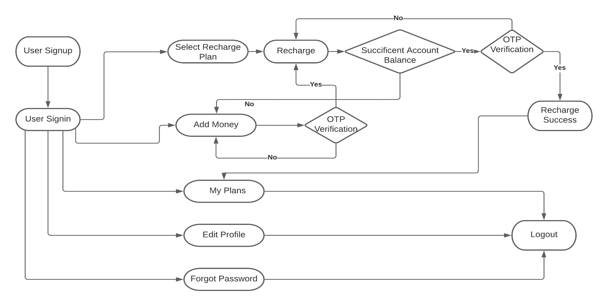
PROJECT FLOW (User)

Slide 7
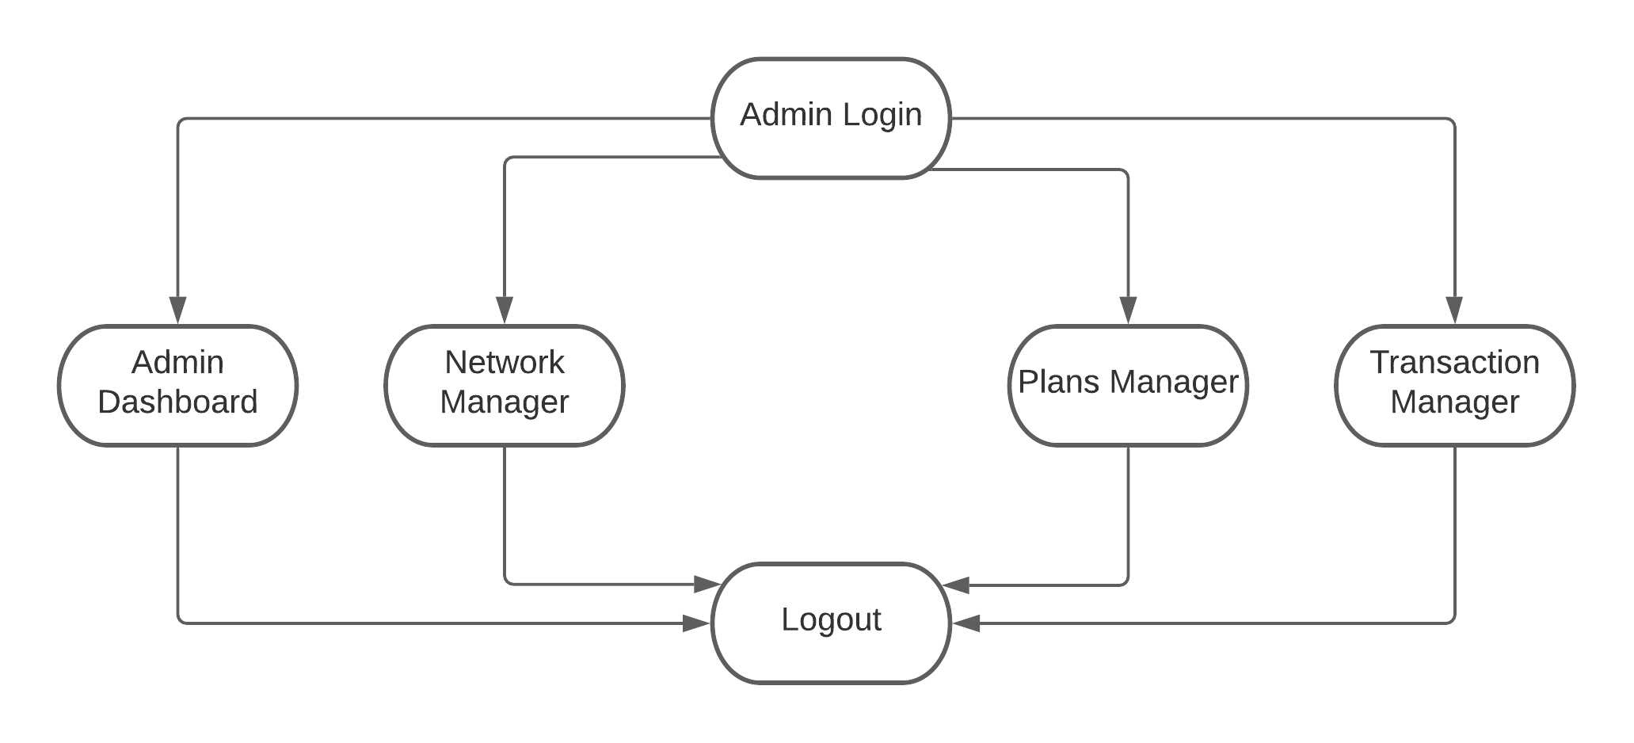
PROJECT FLOW (Admin)

Slide 8
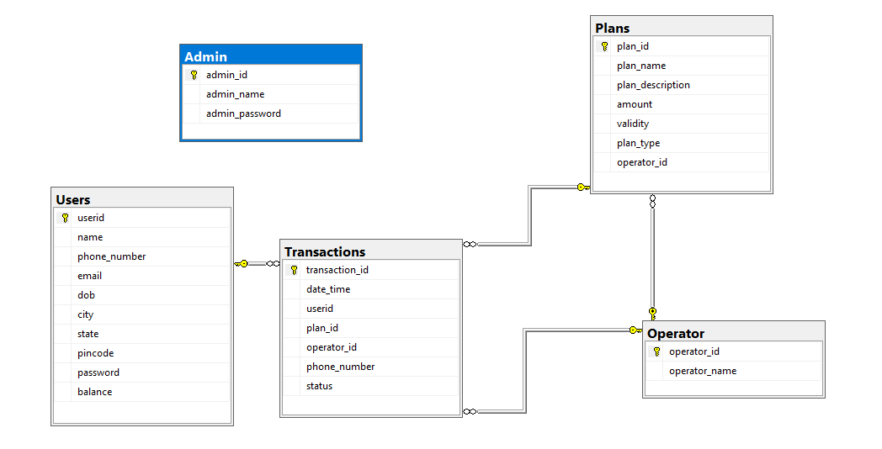
DATABASE DESIGN

Slide 9

USER MODULE
User Module Consists of six important sub modules
Recharge – with email Authentication
My Plans
Add Money to Wallet
Edit Profile
Customer Support
Forgot Password

Slide 10

USER MODULE - Recharge
Recharge Module consists of 4
stages.
Enter Phone Number & Select Plan
OTP Verification – Email Authentication
Recharge Status – Email Notification
New Plan Update in My Plans Section &
Transaction History

Slide 11

USER MODULE – Add Money to Wallet
Users can add money to their wallet using credit / debit card with email authentication.
It consists of 3 stages
Add Required amount & Card Details
OTP Verification- Email Authentication
Add Money Status – Email Notification
Added Money will updated in the user profile
& User Home section

Slide 12

USER MODULE – My Plans
Users can view their current plan
and previous plans transaction history
Users can also recharge their friends
or others mobile number ,the transaction
get update in the plans transaction
history
Also If other user recharge our number,
the current plan will be changed but
transaction will not be updated.

Slide 13

ADMIN MODULE
Admin Module consists of 3 important
sub modules
Network Operator Manager
Plan Transactions Manager
Recharge Plans Manager

Slide 14

ADMIN MODULE – Network Operator Manager
Admin can manage network operators
View Operator details
Add New Operator details
Update Operator details
Delete Existing Operator

Slide 15
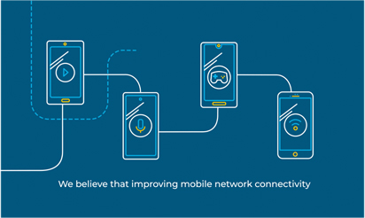
ADMIN MODULE – Plan Transaction Manager
Admin can manage Recharge plan Transactions
View recharge plan transactions
Generate reports in pdf format
based on the recharge plan
transaction details.

Slide 16

ADMIN MODULE – Recharge Plans Manager
Admin can manage Recharge plans
View existing recharge plan details
Add New Plan details
Update existing Plan details
Delete Existing Plans

Slide 17


